Slide 1

HANDWRITTEN THAI NUMBERS PREDICTION

Slide 2

Machine Learning Steps
01
Data collection
- The dataset contains 4,865 images of handwritten Thai numbers (0 to 9) by seven individuals, with corresponding labels.
- The images have dimensions of 28x28 pixels, a white background, and a grayscale font colour.
02
Data Cleansing
- Any images that contained inconsistencies, errors, or anomalies were identified and subsequently removed to ensure that the resulting dataset was cleaner and more reliable.
2

Slide 3
Machine Learning Steps
03
Exploratory Data Analysis
- PCA: Reduces image data dimensionality and identifies significant patterns or features.
- Explained Variance: Helps understand the proportion of variance explained by each principal component in the dataset.
04
Training
- PyCaret's AutoML was used to train the model with 10-fold cross-validation for hyperparameter tuning and model selection.
- The trained model was evaluated using various metrics like precision, recall, F1 score, confusion matrix, and ROC curve analysis.
3

Slide 4
Machine Learning Steps
05
Testing
- A 20% subset of the prepared image dataset was allocated for testing the trained model. The test dataset underwent identical preprocessing steps as the training dataset to ensure consistency.
4

Slide 5
Machine Learning Steps
06
Evaluated Results
Model | Accuracy | AUC | Recall | Prec. | F1
Light Gradient Boosting Machine | 0.90 | 0.99 | 0.90 | 0.90 | 0.90
Extreme Gradient Boosting | 0.89 | 0.99 | 0.89 | 0.90 | 0.89
Logistic Regression | 0.88 | 0.99 | 0.88 | 0.88 | 0.88
SVM - Linear Kernel | 0.86 | 0.00 | 0.86 | 0.87 | 0.86
K Neighbors Classifier | 0.86 | 0.97 | 0.86 | 0.87 | 0.86
5

Slide 6
Machine Learning Steps
07
Improve the model
- User-uploaded images will be saved with their corresponding prediction values. Incorrect predictions will be replaced by user-provided values.
- Model parameters are adjusted when the image count increases by 10%.
6

Slide 7
Machine Learning to GUI for User
GUI
Virtual
Show result with accuracy score
7
Output
The final output from majority votes of top 5 best model
ML
Machine learning
Get one image, image processing, prediction by top 5 best model accuracy score
Input one image
Input only one image for prediction
7

Slide 8

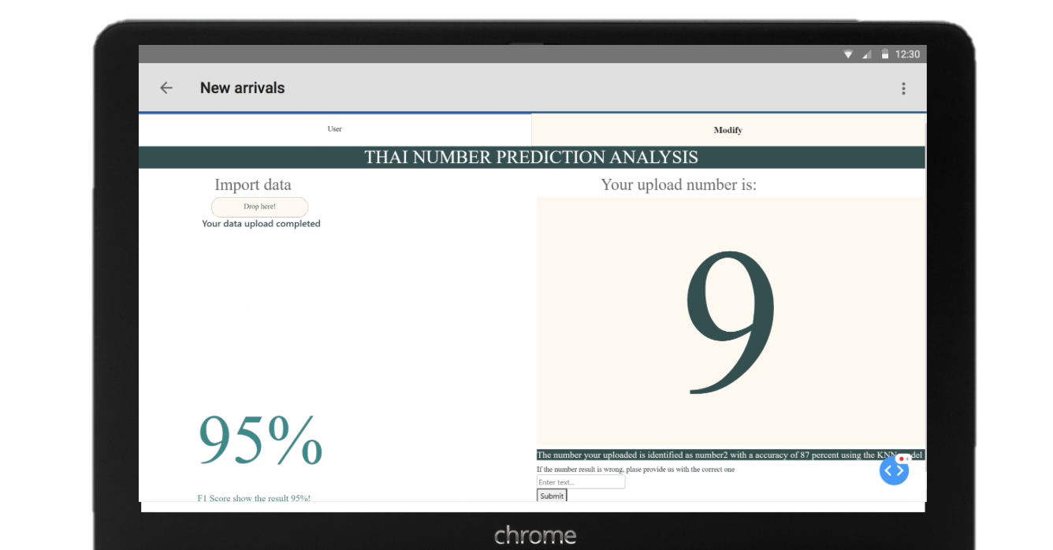
GUI INTERFACE
8

Slide 9
Machine Learning to GUI for
training model
GUI
Virtual
Show result contains AUC,F1 score ,Accuracy ,Recall ,Precision
7
Output
The final output from majority votes of top 5 best model
ML
Machine learning
Set up parameters and utilize PyCaret to create and compare the best accuracy model
Input file(s)
Input new file(s) for prediction then it is collecting by raw data approach
9

Slide 10
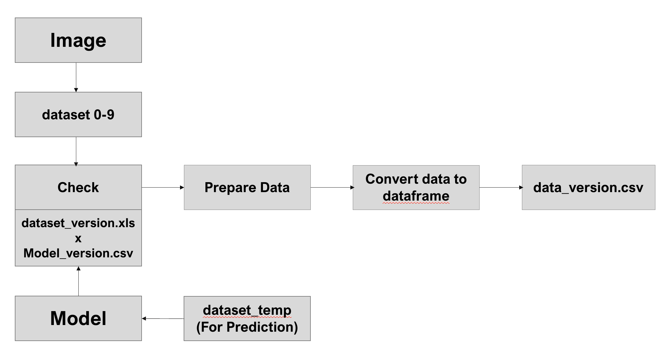
SYSTEM FLOW
10

Slide 11
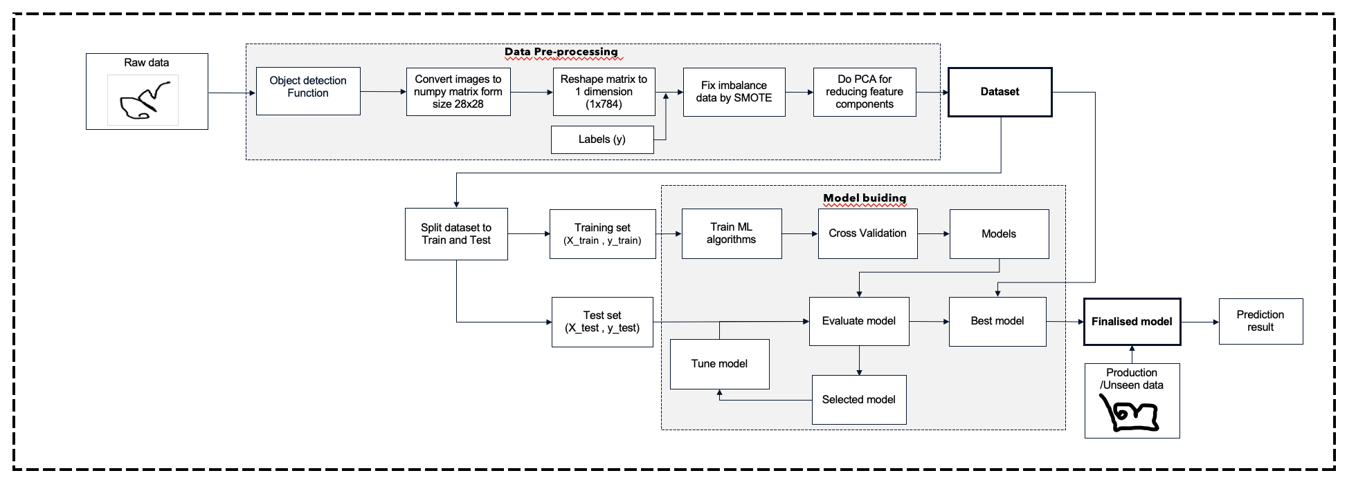
MODEL FLOW
Data Modeling
10

Slide 12
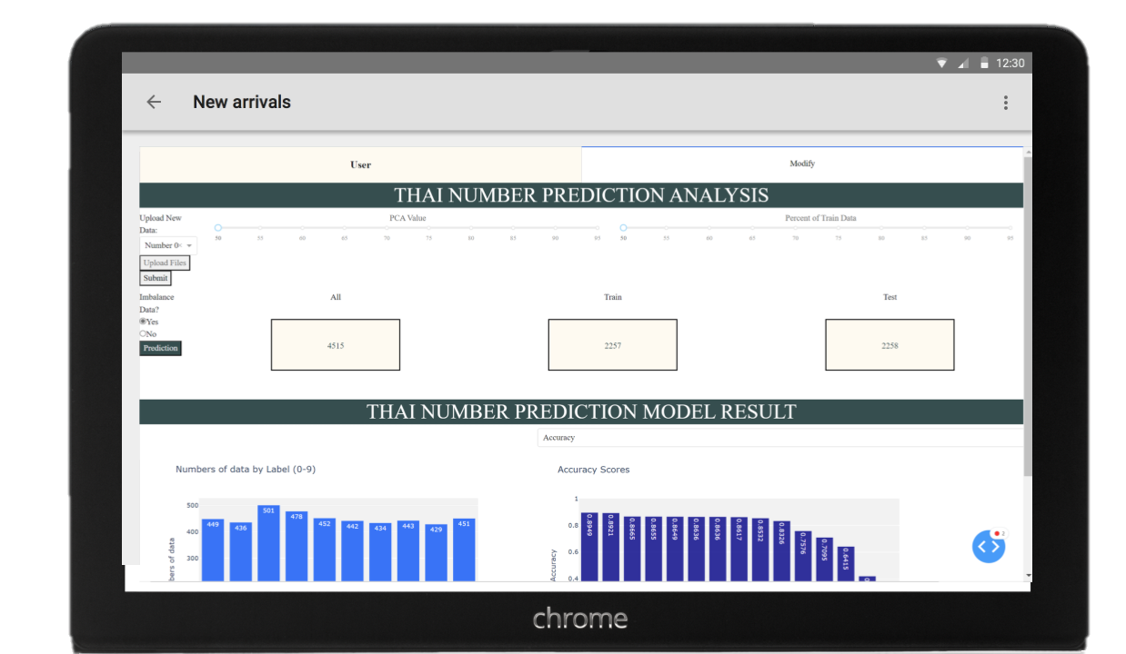
GUI INTERFACE
11

Slide 13
THANK YOU

